Slide 1
Week 1
GEOMETRY AND BASIC MESHING

Slide 2
Gmsh
Gmsh remembers how the geometry touch each other and uses real CAD engines to avoid shape errors
Boundary Representation- Volume by surface, surface by curve, curve by points, points are just locations
mesh can be 1D (lines), 2D (Triangles), 3D (Pyramids or cubes)
Conformal Mesh- Fits perfectly and doesn't overlap or cut
Gmsh builds mesh with bottom-up approach
curves first - Broken in small segments
surfaces next - filled using curve mesh
volumes last - filled using surface mesh

Slide 3
What Gmsh is good at
if geometry has repeated patterns, symmetry, parametric dimensions, lets use of loops and variable, change one number and update whole model
use of parametric model
mixing structured and unstructured mesh, extrude structured mesh and connect to unstructured one
can share parameters with solvers and change inputs in GUI

Slide 4
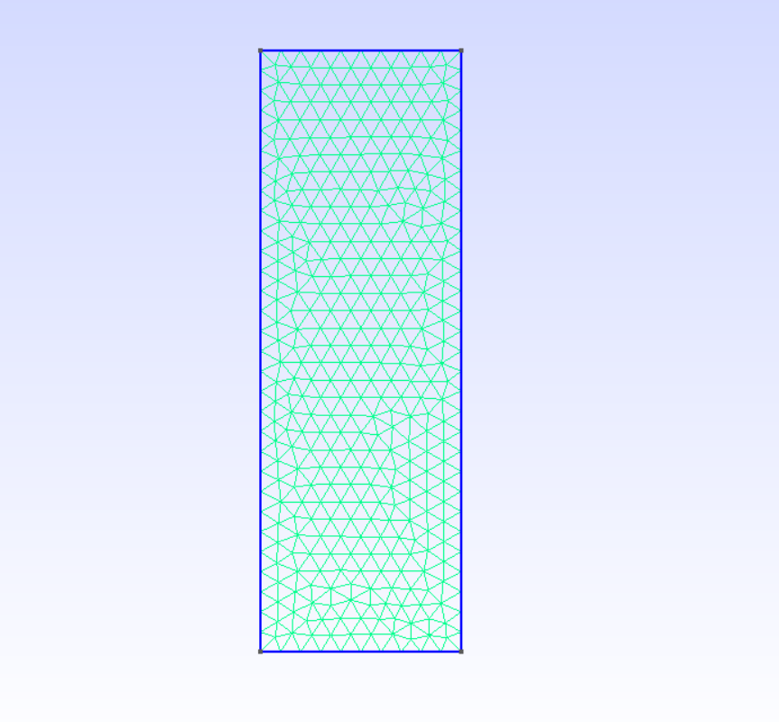
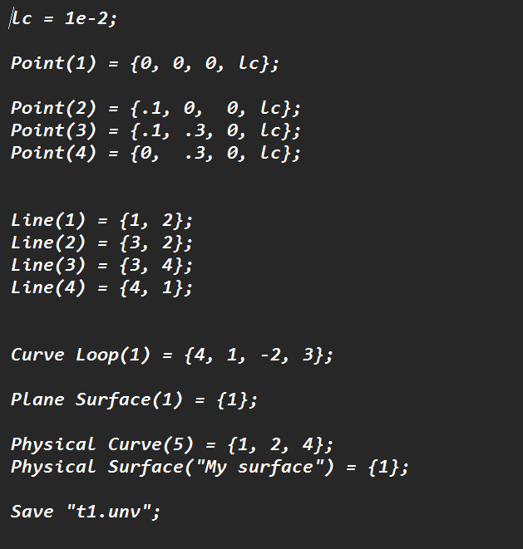
We installed gmsh and started with tutorials. We were able to create geometry in gmsh and also added 2D mesh. We also changed mesh in notepad and were able to save file in .unv and .msh

Slide 5
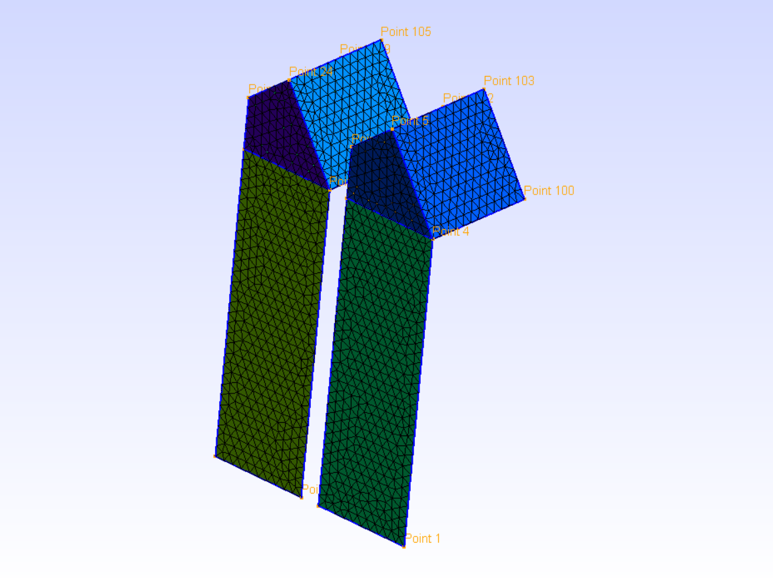
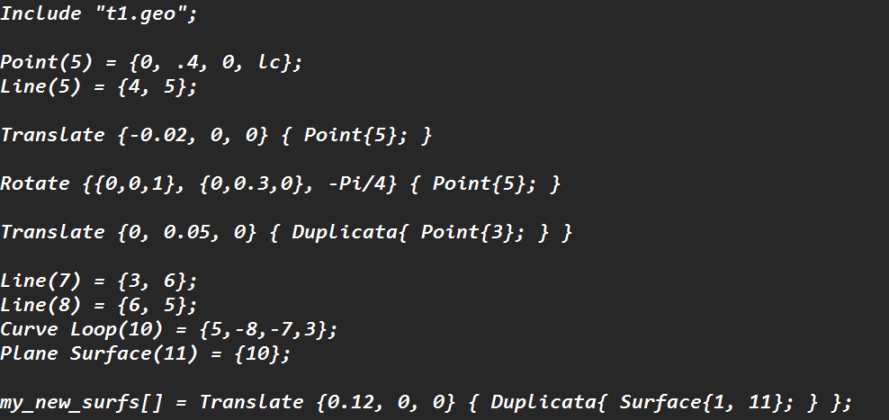
We can move, rotate & duplicate geometry & mesh in gmsh scripting

Slide 6

Creating Lists
We can create lists in gmsh and define any point. Line surface or curve and give them IDs to use later.

Slide 7
MeshSize
The mesh size is an command in gmsh which helps to control the mesh.
This works by selecting the points which we want to have parametric mesh.
It also helps for the points which are not defined by user but got created during extrusion, which apparently don’t have meshsize (Lc) defined
Points which are already created by user and have defined mesh can also be added.
Points may have a defined mesh in them but if these points are added to mesh size, it will be considered as a final command.

Slide 8
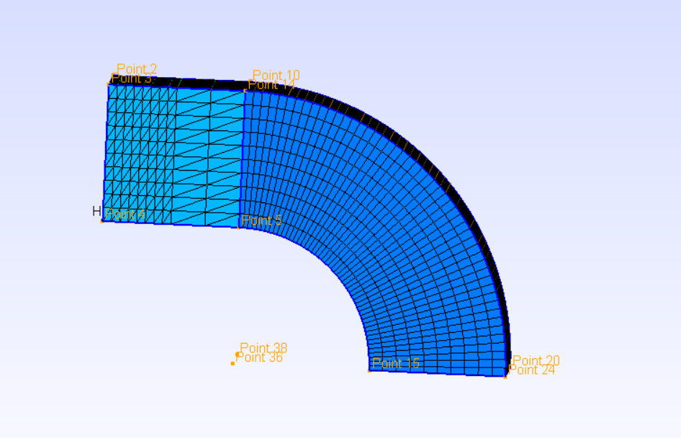
Extrusion
We can extrude geometry and mesh in gmsh and also add number of layers.
More the number of layers, smoother will be the geometry and mesh.
There is also a recombine feature which helps to make unstructured mesh into structured mesh

Slide 9

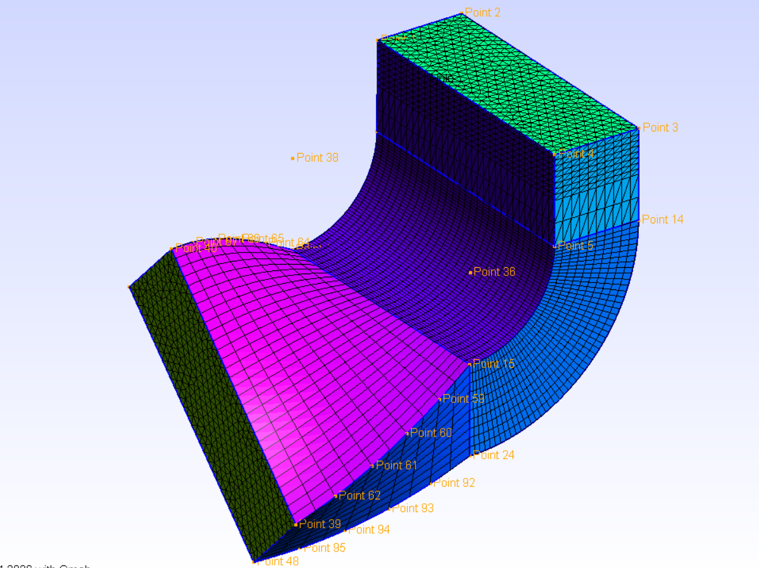
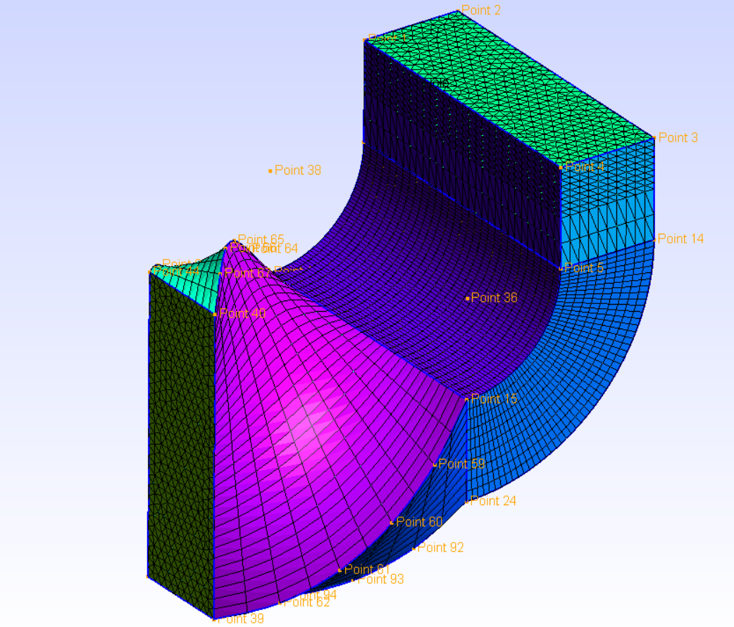
Defining parameters

Slide 10
How does a software knows how to colour
Any FEA post –processor uses Shape Factor to decide colors for the animations
It uses 1st order and 2nd order elements.
1st order uses y= ax + b
2nd order uses y= ax2 + bx + c
2nd order add another element between 2 (adding C in between A&B)
The software then takes 25% of the object and uses legend for adding colours
Eg. If beam AB has A fixed and B Load then as we go towards B the beam bends, lets say that A has red (fixed) and B has blue (deforming) so at C point the software will chooses a mix colour like cyan.

